Slide 1
Smart Home Energy Management System
- S Jayanth

Slide 2
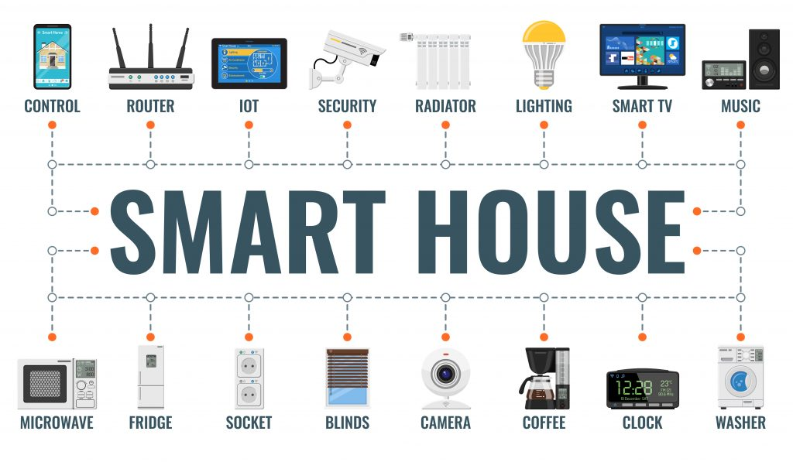
The Smart Home Energy Management System addresses the growing challenge of rising energy consumption and inefficient resource utilization within modern households. As homes become increasingly equipped with electronic appliances and smart devices, monitoring and controlling overall power usage manually becomes complex and impractical.
The Smart Home Energy Management System is an intelligent Java-based solution engineered to enhance residential energy efficiency through automated control and data-driven decision-making.
The platform enables real-time monitoring of power usage, predictive appliance scheduling, and optimized resource utilization.
By integrating smart automation with user-centric insights, the system supports sustainable living while reducing operational energy costs.

Slide 3
Existing Operational Framework
Most households currently rely on manual methods for operating and managing electrical appliances.
Users lack access to analytical insights such as peak usage times, appliance-based energy breakdown, or cost forecasting.
Automation features such as scheduled control, load shifting, or energy optimization are generally absent.
Energy wastage frequently occurs due to appliances being left powered on or operated inefficiently.
Remote monitoring and smart control capabilities are limited or not available in traditional home energy setups.
Decision-making is reactive and user-dependent rather than data-driven or automated.

Slide 4
Solution Overview:
A Java-based Smart Home Energy Management System designed to optimize energy usage, automate device control, and provide intelligent consumption insights.
Functional Modules:
Authentication & Role Management🔐
Secure login and role-based access control.
Differentiated permissions for admin and user roles.
Device Management⚙️
Add, remove, and configure smart home devices.

Slide 5
Real-Time Energy Tracking📊
Live monitoring of appliance-level power consumption.
Analytics Dashboard📈
Visual reports, trends, and consumption summaries.
Data-driven insights to support energy optimization
Scheduling & Automation⏱
Smart rules based on time, usage patterns, or energy goals.

Slide 6
Tech Stack
Front End:Html/CSS/Bootstrap
ThymeLeaf →Helps html with backend
Back End:
Java 17 →Stable version
Spring Boot →Auto configures project and helps to build REST API
JDBC → Connects java to database
Hibernate → for ORM
REST API → Enables easy communication
Data Base:
MySql → table format and structured
Version Control: Git & Git Hub
IDE: IntelliJ/Vs code

Slide 7
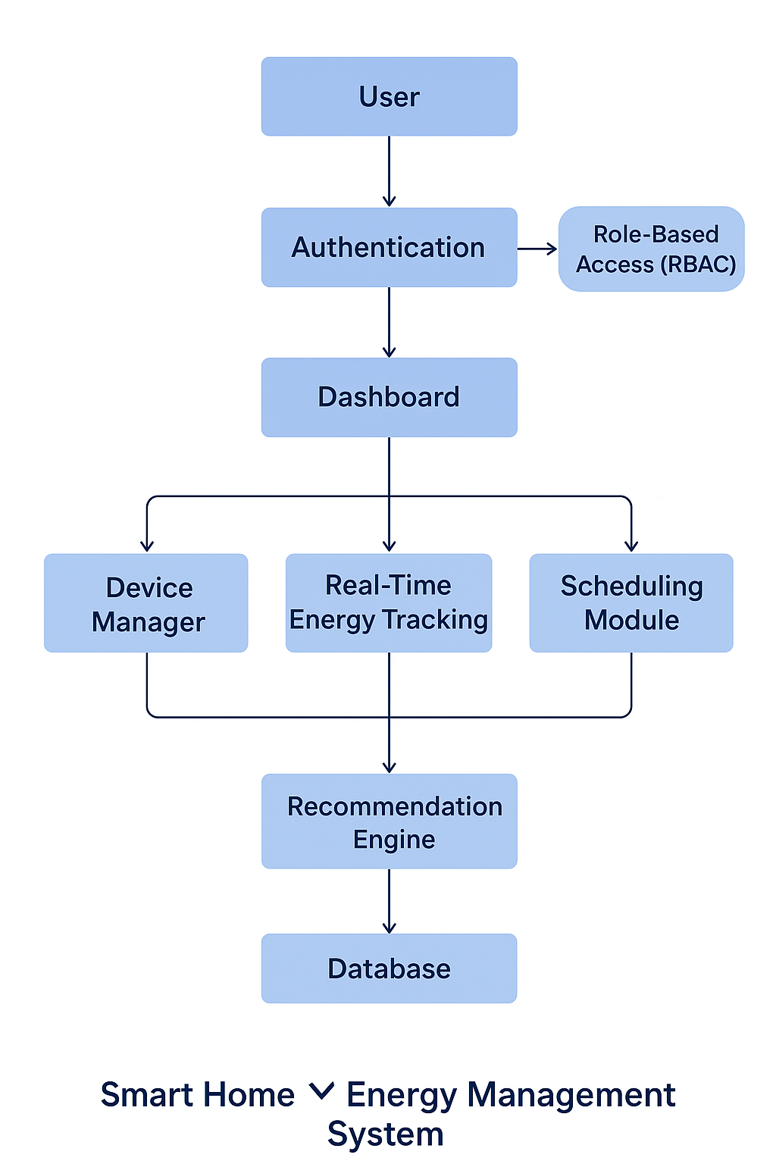
System Architechture

Slide 8
Module -1
Authentication and role management
The Authentication and Role Management module is responsible for validating user credentials and assigning appropriate access privileges within the system. When a user attempts to log in, the system verifies the provided username and password against securely stored credentials in the database. Passwords are stored in an encrypted format to ensure data privacy and protection.
Admins have extended control, including managing users, viewing system-wide energy data, and configuring devices.
Standard Users are provided access to personal dashboards with device control, energy tracking, scheduling, and usage tips.

Slide 9
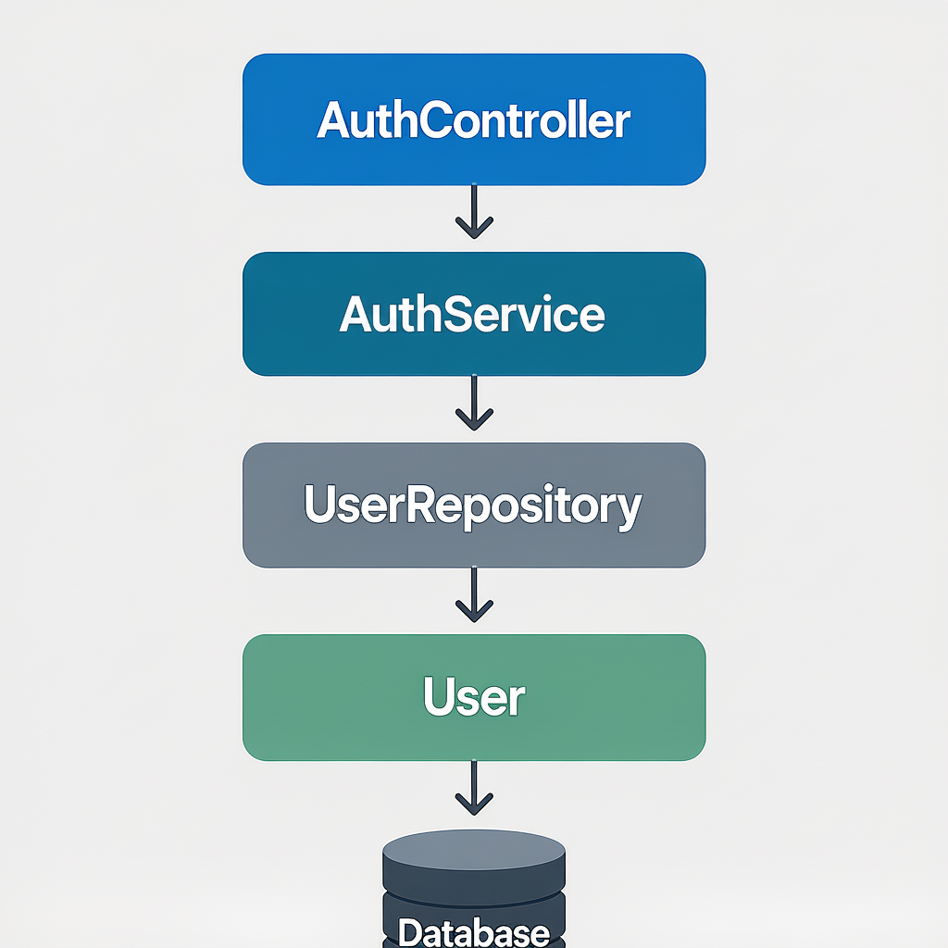
According the four layer approach , the classes are:
AuthController
AuthService
UserRepository
User

Slide 10
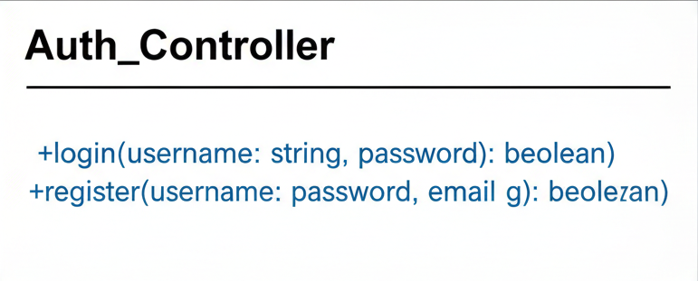
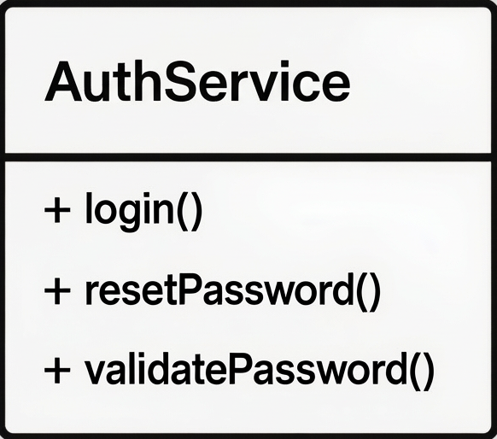
AuthController class →
←AuthService class

Slide 11
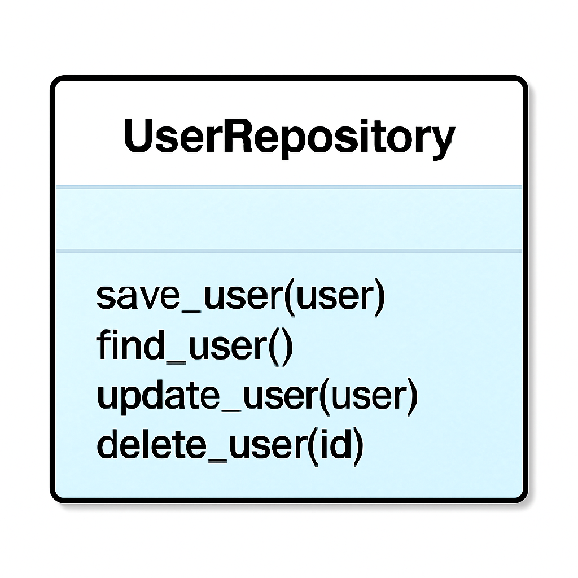
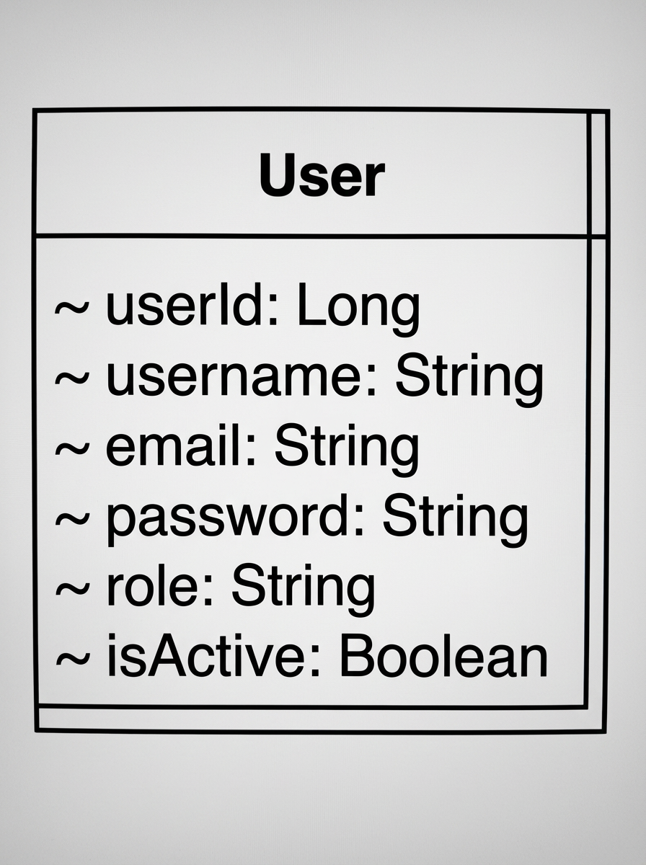
UserRepository class →
← User class()

Slide 12
The DataBase Schema for the USER table as follows:
CREATE TABLE USERS ( user_id BIGINT PRIMARY KEY , username VARCHAR(50) UNIQUE NOT NULL, email VARCHAR(100) UNIQUE NOT NULL, password VARCHAR(255) NOT NULL, user_role VARCHAR(30), is_active BOOLEAN DEFAULT TRUE, phone BIGINT(20) UNIQUE, created_at TIMESTAMP DEFAULT CURRENT_TIMESTAMP);

